Slide 1
Introduction to Test-Driven Development
Christopher Bartling

Slide 2
Programming is the art of telling another human what one wants the computer to do.
Donald Knuth, Stanford University Professor Emeritus

Slide 3
Why Test-Driven Development?
Unit testing is a design activity of software development.
Clarifies the intent of our code.
Forces you to concentrate on the responsibility assigned to a method or function.
Forces you to solidify contracts between dependencies.
Unit testing exerts cognitive pressure on the developer to abide by a set of design principles (SOLID, GRASP, others).
A unit of code that is testable typically coincides with these design principles.
Unit tests communicate the soundness of design decisions.
Unit tests help us prove basic correctness of our solution.
Unit tests act as executable documentation.

Slide 4
Benefits of test-driven development
Constantly asking yourself what it is you want to accomplish.
Forces you to deeply contemplate the problem domain as new functionality is added to the system.
Make code changes with confidence.
Write better designed code that is adaptive to change and has fewer bugs.
Force you to create smaller functions that do one thing.
Document your code by giving usage examples.

Slide 5
Unit testing as a feedback loop
We apply feedback loops to every level of our development.
Unit testing is an excellent feedback loop that occurs within seconds.
Quick execution of a unit test suite provides us with update-to-date information about our codebase.
Constant testing automation (CI build) with a test suite with good test code coverage can catch regression errors during development.
Test-driven development gives us feedback on...
Quality of the implementation (does it work)
Quality of the code design (is it well structured)

Slide 6
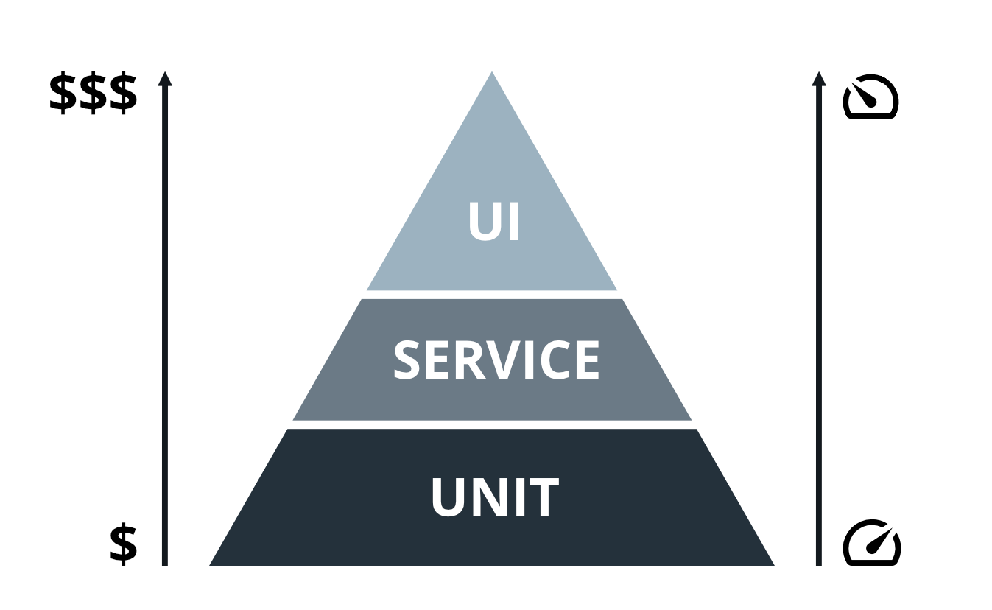
Testing Pyramid

Slide 7
Unit vs. Integration Tests
Isolated methods or functions.
Focus on allocating responsibility and proving basic correctness.
Execute quickly.
Test doubles usage.
Written along with code, hopefully test-first.
Created and maintained by developers.
Integrate components together.
Connect to databases, caches, messaging systems, external APIs, and other dependencies.
Execution can be slower.
External dependencies can be difficult to control.
Focus on verifying component integration.

Slide 8
Unit testing focus
Write unit tests as you write your code for each component of your system.
Contracts specified as interfaces.
Collaboration tests
Contract tests
Use unit tests to refactor your code.
Not much planning needed to start unit testing.
Unit tests are isolated from external dependencies.
Just Do It!

Slide 9
Integration testing focus
Integration testing happens after you have written your components.
Ensures that the newly created components can be wired together with real dependencies to provide functionality.
Any deviations detected from integration testing can be used to add test coverage at the unit test level and to influence code design decisions.
Integration testing requires significant planning.
How will dependencies be managed for the integration test suite?
How will state be managed between tests?
How do we test with external dependencies that we cannot control?

Slide 10
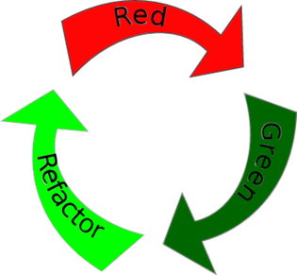
Test-Driven Development Cadence

Slide 11
Test-Driven Development Cadence
Write a failing, high value test.
Demonstrate that it communicates its failure well.
Make the high value test pass by providing implementation code.
The implementation code may be messy at this point.
Run the entire test suite to ensure all tests pass.
Refactor your code, running the test suite after each change.
Determine your next most valuable test, repeating the cycle.

Slide 12
What makes a good unit test
Tests should be…
Unique
Written at the right level of abstraction
Expressive
Based on acceptance criteria
Implementation independent
Knowing how to write a good test is paramount to being successful with TDD.

Slide 13
Don’t be clever!
Prefer clarity over cleverness.
Developers spend much more time reading code than writing code.
Optimize your source code for reading.
Make your code as easy to understand as you possibly can.
If you encounter code that is not easy to understand, take a little time to refactor it.
“Maintainable code is more important than clever code.” – Guido van Rossum, inventor of the Python language
“Simplicity is a prerequisite for reliability.”- Edsger W. Dijkstra

Slide 14
Accidental vs. essential complexity
Software should behave predictably and accomplish its goals without too many surprises (that is, outages in production).
The number of surprises directly correlates with the amount of unnecessary complexity found in a project.
Accidental complexity relates to problems which engineers create and can fix, [whereas] essential complexity is caused by the problem to be solved, and nothing can remove it – Fred Brooks in his seminal “No Silver Bullet” essay
Push back when accidental complexity is introduced.

Slide 15
Don’t Repeat Yourself (DRY)
Copy-pasta coding
Doing the same or almost the same things in multiple places in the code.
DRY things up! Refactor to reusable behavior.
Less code is easier to maintain and debug.
Small functions are easy to test.
Some development tools detect duplicate code and warn you about it, and some even help you extract methods or functions from the duplications.

Slide 16
YAGNI
Tempting to write some extra code because you think you will need it later on.
This can happen when design simplicity is not followed.
Nobody dares to remove it because who knows what will break if they do.
Unused code does not get updated.
It can introduce bugs and security vulnerabilities that didn’t have to be there in the first place.
Don’t write code that you don’t need right now.
Unit testing ensures that you are solving the problem at hand.

Slide 17
Minimal APIs
Writing clear, minimal APIs is key to managing simplicity in software systems.
Smaller APIs with fewer methods and arguments are easier to understand and test.
Allow us to put more effort into comprehending the actual problem we set out to solve.
Less is more.

Slide 18
Refactoring
Restructuring your code without changing its behavior.
Software is rarely perfect on the first attempt.
It may work, but it will be messy, and there will be code smells.
Software is continuously evolving.
Work to continuously improve it.
Even if you start with a perfect code base, it can get messy very quickly.
Leave a piece of code better than you found it, every time.
Small improvements over time add up to a codebase that is easy to read and maintain.

Slide 19
TDD vs ATDD
TDD
ATDD
Focus on individual methods and functions
Written by developers
Tests are isolated and use test doubles for dependency isolation
Tests execute quickly (ms)
Easy to test exceptional pathways through the code
Focus on scenarios
Written by quality assurance and potentially developers
Tests integrate the entire stack of components together
Tests require setup and can be slower to execute (seconds)
More difficult to simulate exceptional scenarios

Slide 20
Further reading
Test-Driven Development: By Example by Kent Beck
Working Effectively with Legacy Code by Michael C. Feathers
Growing Object-Oriented Software, Guided by Tests by Steve Freeman and Nat Pryce
Beyond Legacy Code by David Scott Bernstein

